Slide 1



Java, data and Git

Slide 2
Java
Java code
The JVM is what allows java to run anywhere.
JavaC (compiler)
Bit file (.class)
JVM
JVM
JVM
JVM
Linux
Unix/ MacOS
Windows
Any other system

Slide 3
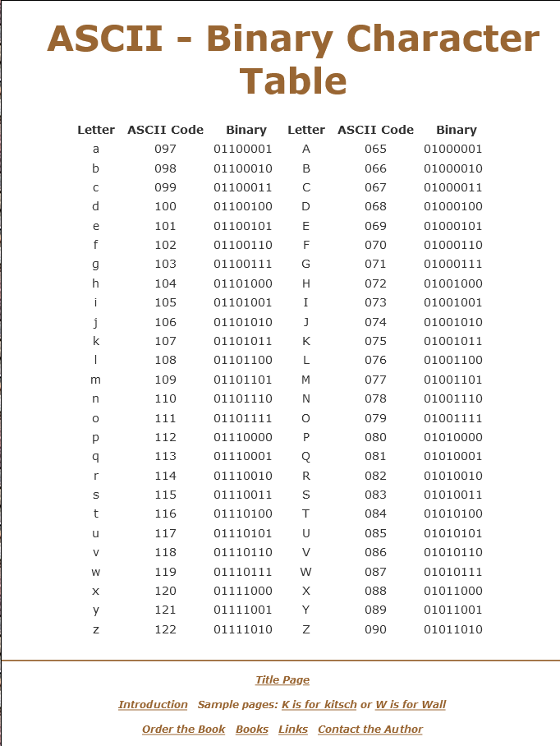
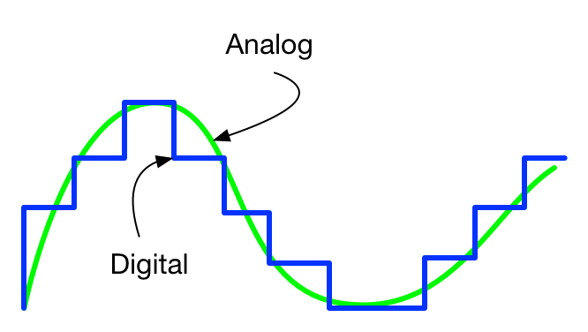
Digital and analog
The only thing that a computer can interpret are 1s and 0s, this is a digital signal, like the press of a button.
Anything else that isn’t a 1 and a 0 has to be represented as such.
With a signal that is coming from a potentiometer, for example, is an analog signal that is represented by a digital number, the resolution is called bit depth.

Slide 4

Bits, Bytes, Bit depth
For every byte you have 8 bits, each byte is can be a number or even letters, 8 bit computers used to work this way, and text can be assigned a byte value.
The bit depth, resolution, sample rate, all names for the same things is represented in this graph.
Everything gets a representation of 0s and 1s, a double is a 64 bit representation of a number that uses does 64 bits to give it insane precision.

Slide 5
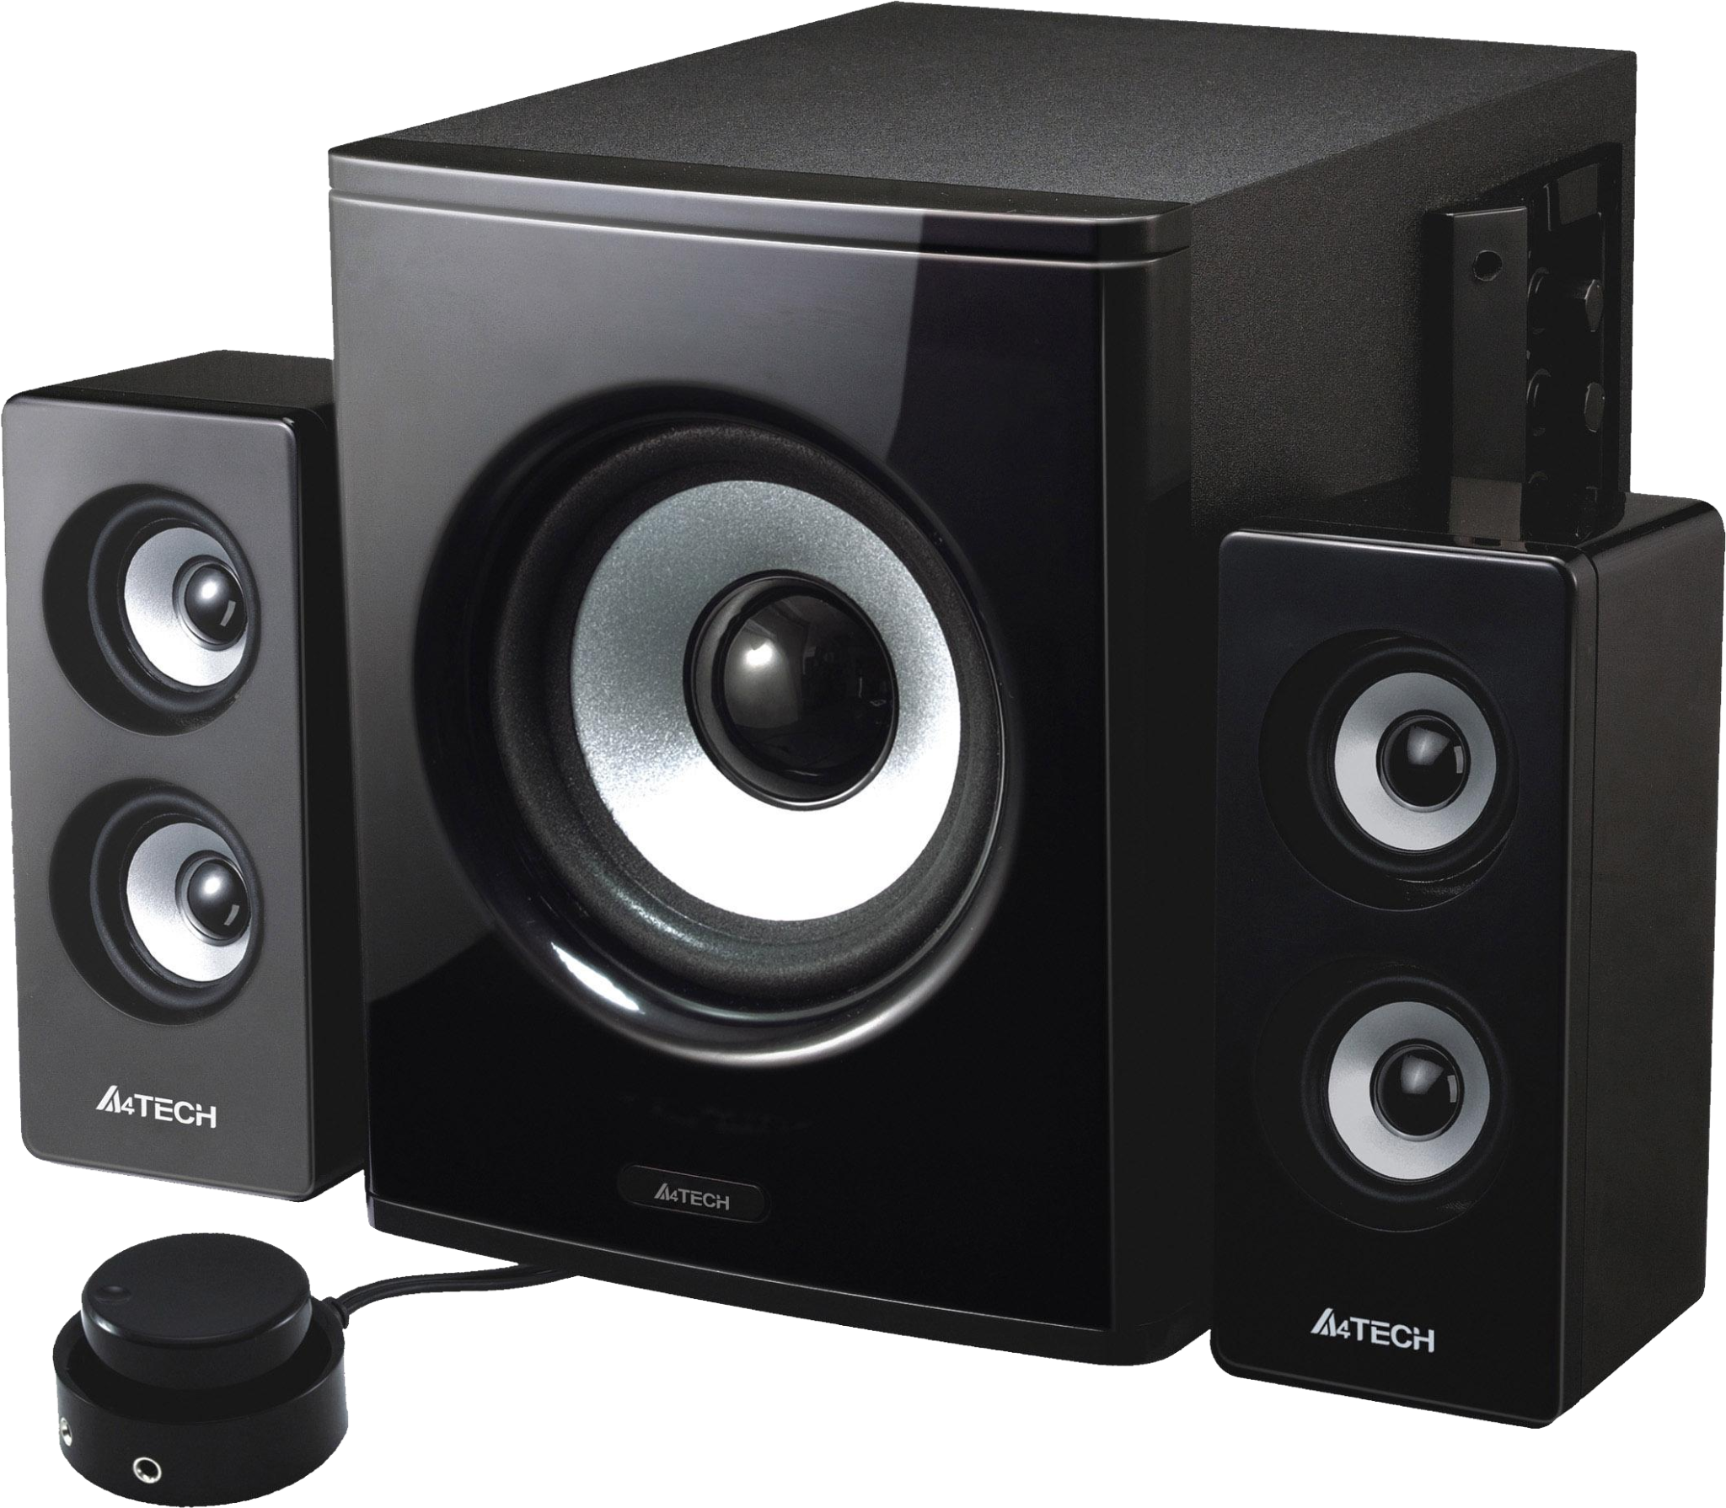
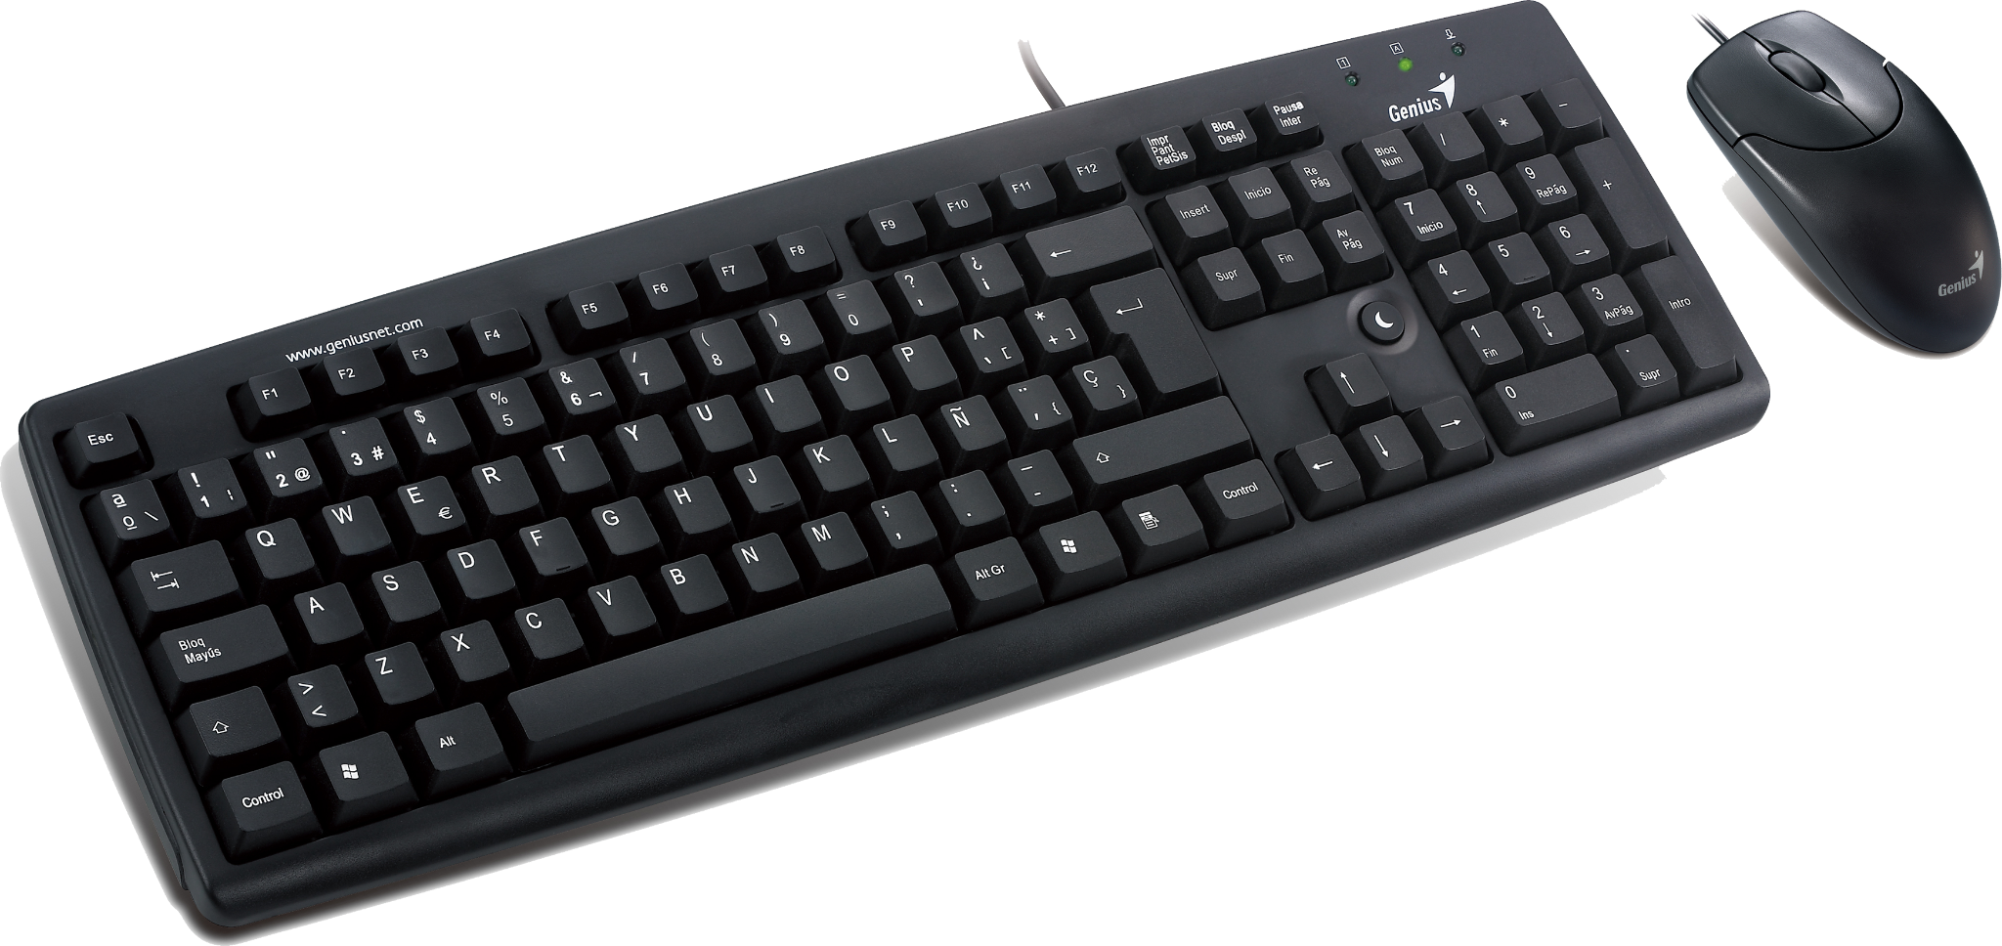
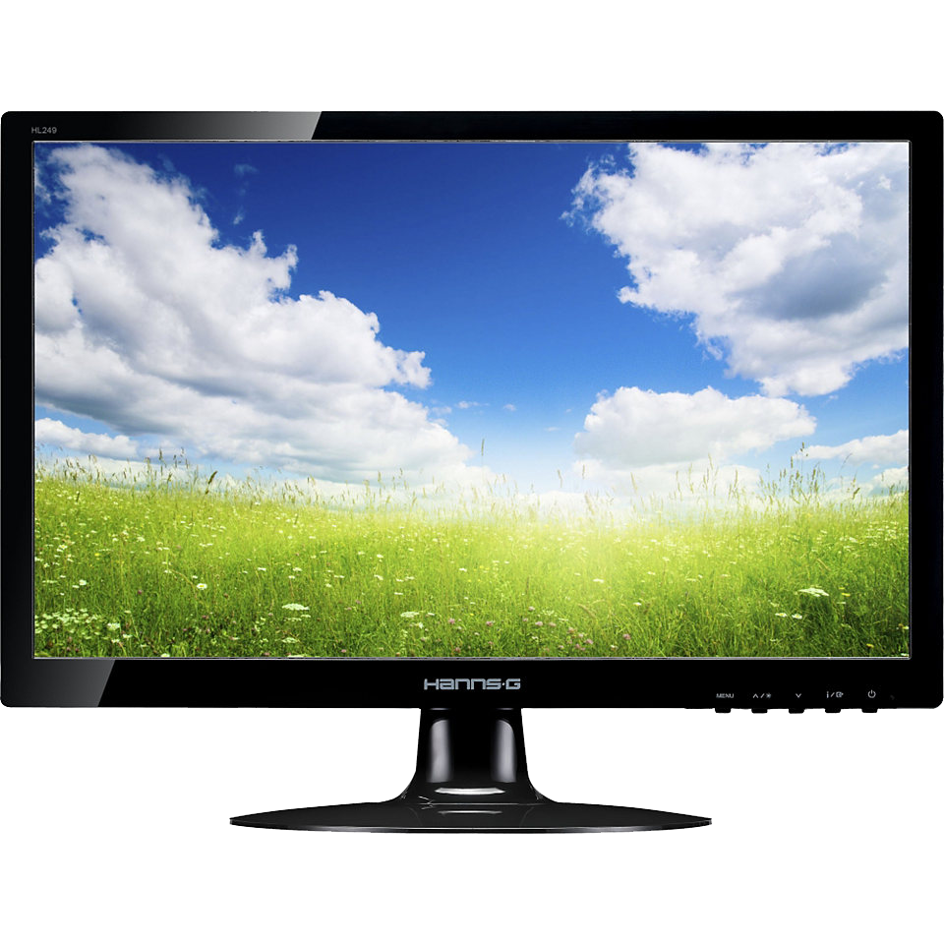
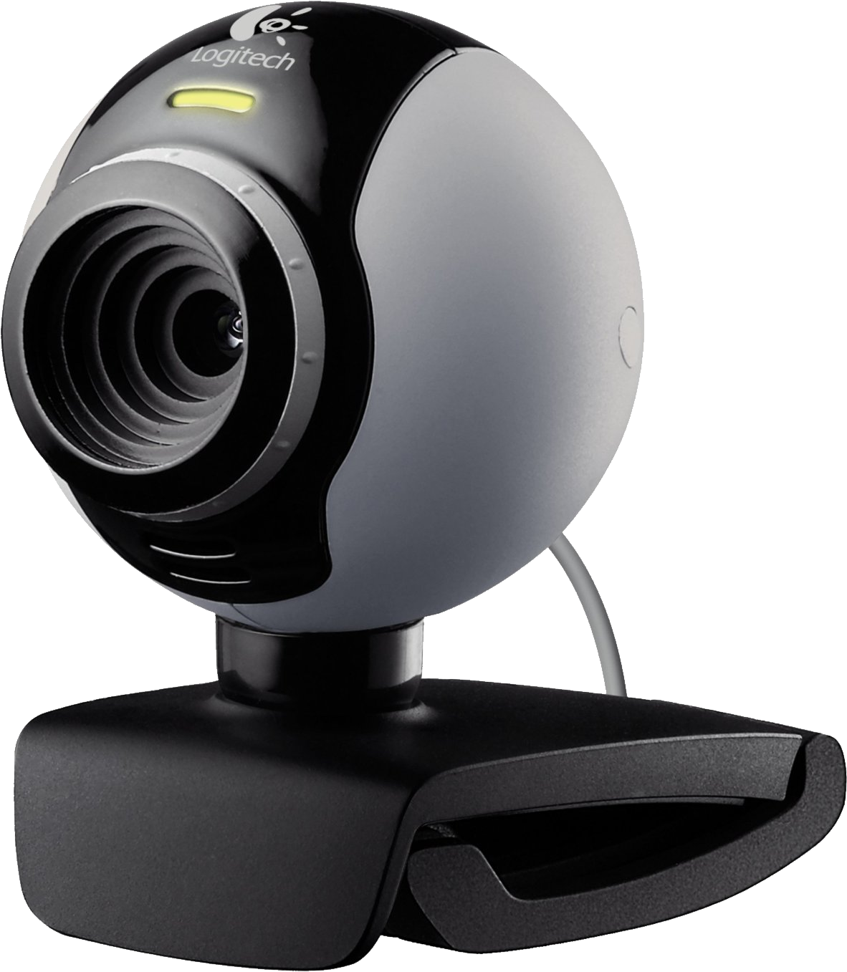
Inputs and outputs
The way a machine can do and see things.
Machines and the things that run code, don’t have eyes, noses, ear, arms, legs, etc.
Inputs are the things that give the “brain” the processor information, and the outputs are what the processor writes to.
Inputs outputs

Slide 6
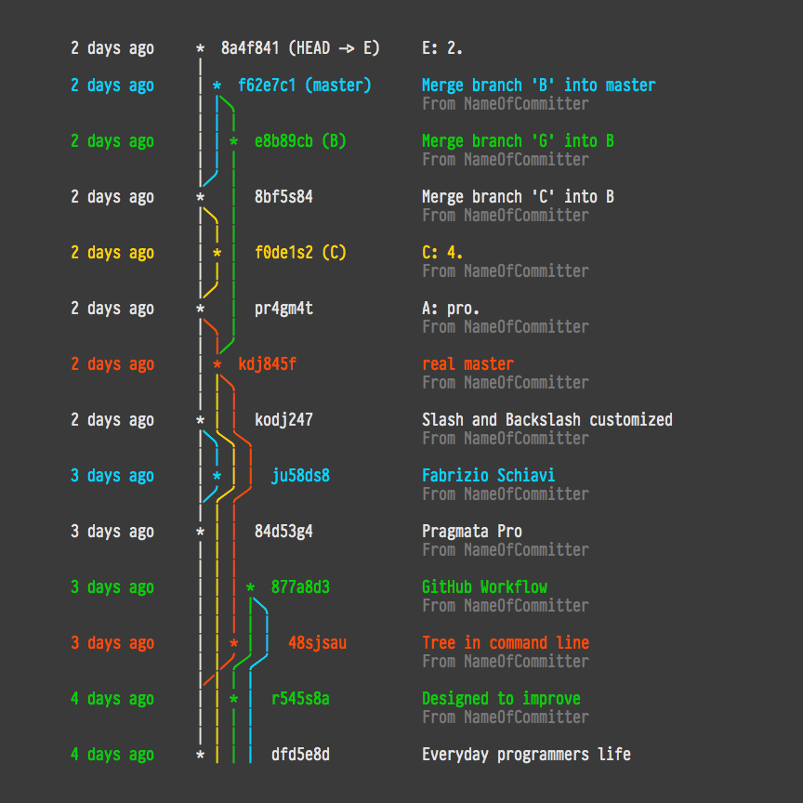
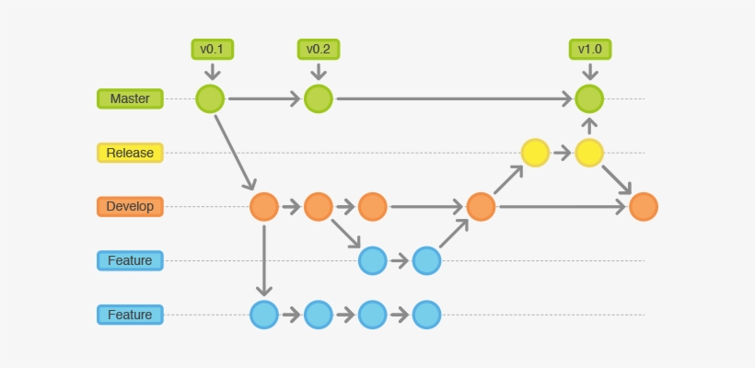
Git
Git the industry standard for code management.

Slide 7
